Slide 1

TEAM 8 – HS3

Slide 2
Agenda
Problem | Sahil
Key issues
Recommendation
Analysis | Haris
Implementation | Stephanie
Outcome | Samuel

Slide 3
Problem
Significant gap in affordable housing projects in NL leading to housing insecurity and homelessness

Slide 4
Key Issues
Homelessness
Inadequate Housing
Unsuitable Housing
Unaffordable Housing
Vulnerable Populations Facing Housing Insecurity

Slide 5
Recommendation
Increase Social Housing
Increase Urban Density with Apartments (Urban)
Establish Tiny Home Villages (Rural)

Slide 6
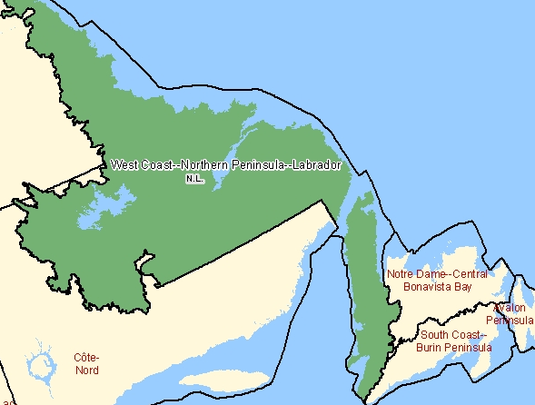
Analysis
0.5 million population
Divided NL into 4 regions
372 subdivisions
274 towns
92 Unorganized subdivisions
3 Cities & 3 Indian Reserve
Sources: Statistics Canada, CMHC, Housing assessment resource tool (HART)
Notes:
St. john’s mt pearl, corner brook

Slide 7
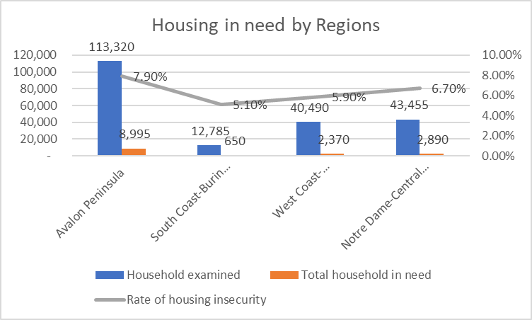
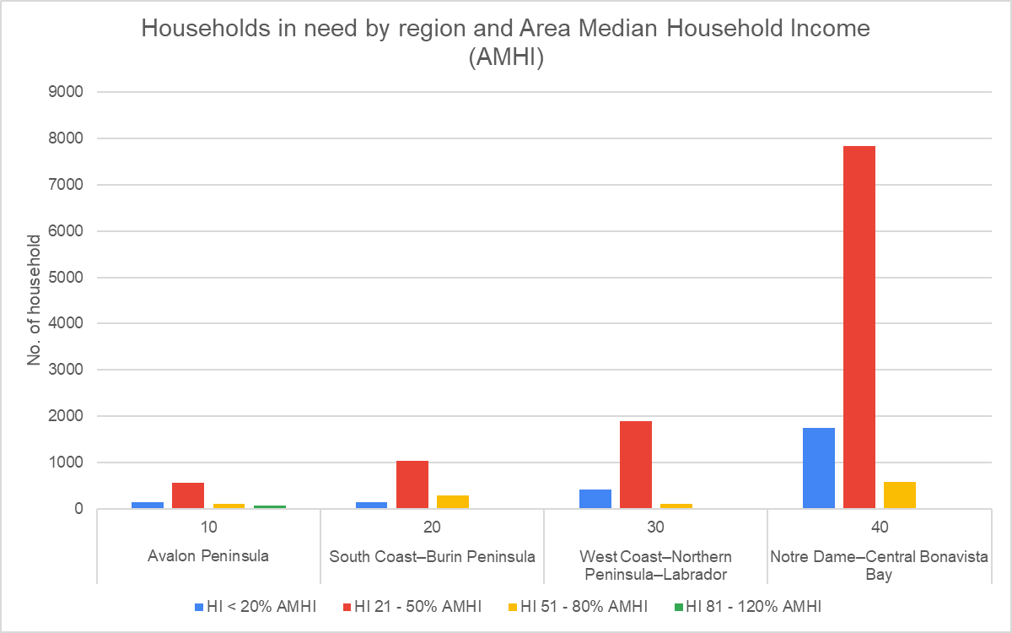
Analysis

Slide 8
Analysis
Takeaway: Housing insecurity rate hovers around 7-8%.
There is some relation between AMHI and housing insecurity in Central region

Slide 9
Analysis
7.1%

Slide 10
Analysis
7.1%
Takeaway: Housing crisis is speared equally across Cities and towns. Hence separate strategy is needed for both

Slide 11
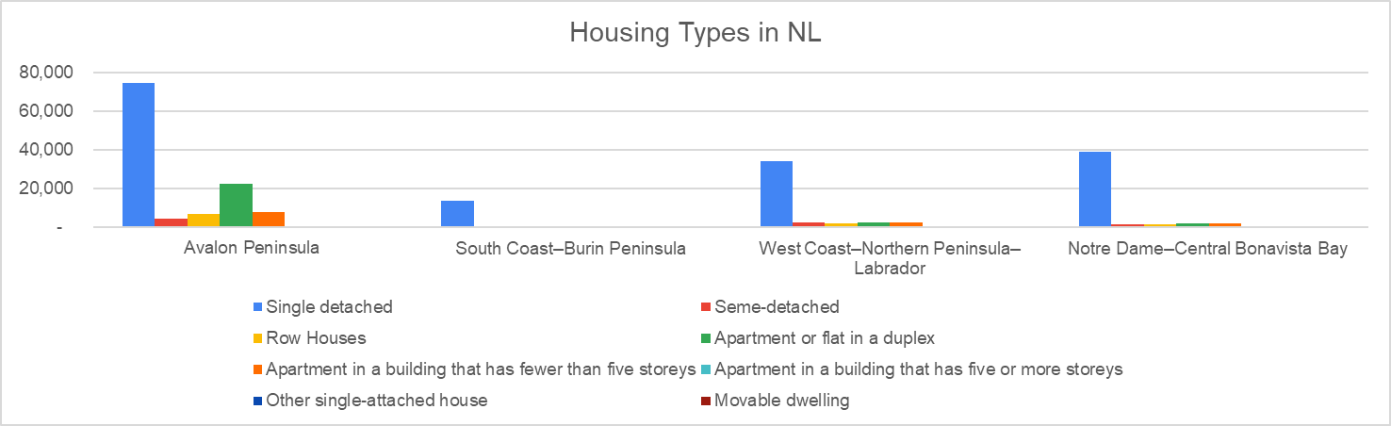
Analysis

Slide 12
Analysis
Takeaway: NL has low urban density

Slide 13
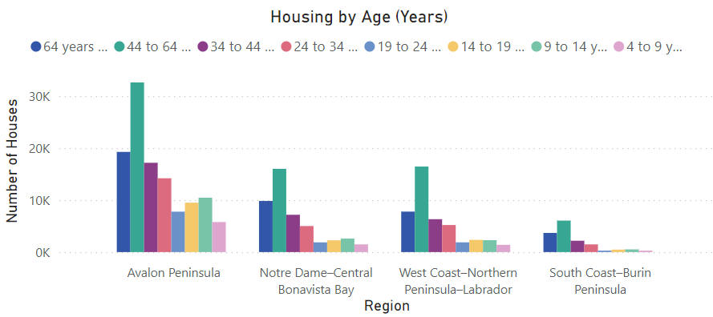
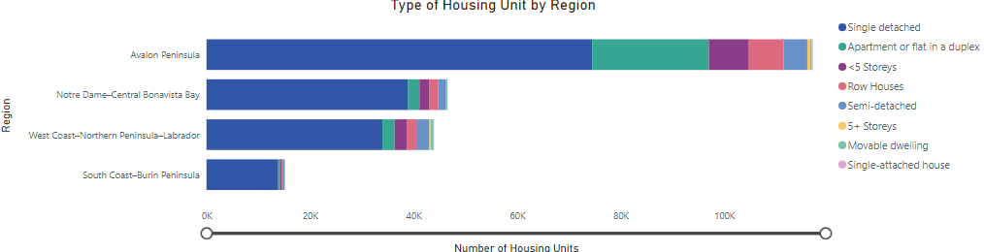
Analysis

Slide 14
Analysis
Takeaway: Housing construction has slowed down after 2000s
Single detached housing dominates across all regions

Slide 15
IMPLEMENTATION

Slide 16
Increase Social Housing
Social housing expansion is key to addressing housing insecurity in NL.
Only 3.1% of NL’s housing stock is social housing, among the lowest in Canada.
National average: 3.5% social housing; recommended target: 7.5%.
Proven History of Success
Vienna, Austria: Nearly 50% of residents live in municipally owned/subsidized housing.
Vienna’s model shows success in affordability and social inclusion.
Adaptation Strategies
Public-Nonprofit Partnerships
Mixed-Income Communities
Utilize Municipal Land
Recommendations
Increase social assistance shelter allowances for low-income recipients and persons with disabilities to be able to afford their shelter costs. (Provincial)
Further explore the feasibility of a conversion strategy for older hotels and long-term care home type buildings being demolished for redevelopment into supportive housing (also a preservation strategy).
Identify and allocate suitable municipal land for the development of non-market housing, including supportive living units. (Municipal)

Slide 17
Increase Social Housing
This is a long-term strategy. Estimated timeline is as follows:
0-6 Months:
Increase provincial shelter allowances for low-income recipients and persons with disabilities.
Identify and allocate municipal land for non-market housing, prioritizing supportive units.
Establish partnerships with not-for-profit developers and community land trusts.
1-3 Years:
Pilot conversion of older hotels and care facilities into supportive housing.
Launch construction on allocated land, leveraging public and private funding.
Monitor progress and adjust shelter allowances as needed.
5-10 Years:
Scale conversion and non-market housing projects based on results.
Reinvest profits to sustain future housing developments.
Preserve affordable units to prevent conversion to market-rate housing.

Slide 18
Increase Urban Density with Apartments
Compact, transit-oriented housing lowers infrastructure costs and mitigates sprawl.
Supports affordable living and reduces car dependency.
Promotes sustainable economic development through denser urban living.
Proven History of Success
Helsinki, Finland: Successful model with mid-rise apartments and integrated green spaces.
Demonstrates how urban densification fosters livable, sustainable communities.
Adaptation Strategies
Transit-Oriented Development
Mixed-Use Developments
Leverage Existing Urban Spaces
Recommendations
Eliminate unit maximums on all forms of residential housing
Abolish parking minimums on residential, commercial, and industrial properties
Adopt ambitious as-of-right density permissions near transit
Eliminate the PST on purpose-built rental (PBR) construction (Provincial)
Align property taxes for PBR with those of condos and low-rise homes. (Municipal)

Slide 19
Increase Urban Density with Apartments
This is a medium-term strategy. Estimated timeline is as follows:
0-6 Months:
Remove unit maximums for residential housing across NL.
Eliminate parking minimums for residential, commercial, and industrial developments.
Begin identifying priority transit areas for high-density development.
1-2 Years:
Implement as-of-right density permissions near identified transit hubs.
Launch pilot projects in St. John’s and Corner Brook to test the new policies.
Monitor impacts on housing availability, affordability, and transit use.
3-5 Years:
Expand successful pilot projects and incentivize further private investment in dense, mixed-use developments.
Review zoning and permitting policies to ensure long-term alignment with density goals.
Track market stabilization and adjust policies as needed to maintain affordability and accessibility.

Slide 20
Establish Tiny House Villages
Tiny home villages address homelessness with affordable, supportive housing.
Provide shelter and integrate essential services for stable living transitions.
Proven History of Success
Tiny Home Villages in Fredericton and Halifax
Adaptation Strategies
Streamline Zoning and Permitting Processes
Collaborate with Local Organizations for Support Services
Utilize Public-Private Partnerships for Funding
Recommendations
Collaborate with municipalities to allocate land near essential services and fast-track zoning approvals.
Combine Public-Private Funding (Frederickton Model)
Ensure wraparound services like healthcare and job training to promote stability and long-term success are offered on-site or very close by.

Slide 21
Establish Tiny House Villages
This is our shortest-term solution. Estimated timeline is as follows: 0-6 Months:
Collaborate with municipalities to identify and allocate land near essential services.
Fast-track zoning approvals to allow for immediate construction starts.
Secure initial funding through a mix of public grants and private sector contributions, following the Fredericton model.
6-18 Months:
Begin construction using modular or prefabricated methods to expedite the process.
Phase in wraparound services (e.g., healthcare, job training) on-site or nearby to support residents transitioning into housing.
18-24 Months:
Complete construction of the village and ensure all support services are fully operational.
Monitor resident outcomes and community integration to inform future expansions or improvements.

Slide 22
Final Proposal
 | Avalon Peninsula | South Coast–Burin Peninsula | West Coast–Northern Peninsula–Labrador | Notre Dame–Central Bonavista Bay
Estimated Change to Core Housing Need | -6.48% | -7.34% | -14.22% | -2.21%
Single-detached Houses | 939 | 937 | 937 | 937
Semi-detached Houses | - | - | - | -
Row Houses | - | - | - | -
Apartments or flats in a duplex | - | - | - | -
Apartments in a building that has fewer than five storeys | 6450 | - | 4800 | -
Apartments in a building that has five or more storeys | - | - | - | -
Proposed incentives (if applicable): Outlined in implementation

Slide 23
QUESTION?

